Slide 1



Creative Commons: an introduction
Jessica Coates
Project Manager
Creative Commons Clinic
AUSTRALIA
part of the Creative Commons international initiative
CRICOS No. 00213J

Slide 2

What can you do without permission?
Email a news article to a friend?
Download a song onto your hard drive?
Post a picture/song/film onto your blog page?
Use a song in a podcast or in the soundtrack of a short film?
Create a remix or mash up out of video/music clips?
Record a cover song?
AUSTRALIA
part of the Creative Commons international initiative
CRICOS No. 00213J

Slide 3
What can you do without permission?
Email a news article to a friend?
Download a song onto your hard drive?
Post a picture/song/film onto your blog page?
Use a song in a podcast or in the soundtrack of a short film?
Create a remix or mash up out of video/music clips?
Record a cover song?
No
No
No
No
No
No
AUSTRALIA
part of the Creative Commons international initiative
CRICOS No. 00213J

Slide 4
Enter Creative Commons
Aims to make creative material more usable by providing free licences that creators can use to give permission in advance
AUSTRALIA
part of the Creative Commons international initiative
CRICOS No. 00213J
Notes:
Non-profit
Founded in 2001
These academics became concerned that the default copyright laws that applied in most countries were restricting creativity in the digital environment by preventing people from being able to access, remix and distribute copyright material online
Taking inspiration from the open source movement, they decided to develop a set of licences that creators could use to make their material more freely available without giving up their copyright
They wanted to replace the standard “all rights reserved” model with a new, more flexible, “some rights reserved”

Slide 5




Licences
4 licence elements:
        Attribution – attribute the author
        Noncommercial – no commercial use
        No Derivative Works – no remixing
        ShareAlike – remix only if you let others remix
AUSTRALIA
part of the Creative Commons international initiative
CRICOS No. 00213J
Notes:
The first CC licences were released in 2002
The central to each of the CC licences are the four licence elements – Attribution, noncommercial, no derivative and sharealike
These represent restrictions that copyright owners may want to put on how people can use their material.
As you can see, each of the elements has a symbol that can be used to ‘represent’ each of these elements
this makes the licences easier understand – in theory, once a person is familiar with the CC licences, they should be able to recognise what uses are allowed simply by looking at the symbols

Slide 6
Licences
creators mix and match these elements to make a licence eg:
  Attribution-Noncommercial-ShareAlike – can remix, tweak, and build upon the work, as long as:
    you credit the author;
    it is for non-commercial purposes; and
    you license your new creations under the same licence
AUSTRALIA
part of the Creative Commons international initiative
CRICOS No. 00213J
Notes:
Users can mix and match these elements to set the conditions of use for their material
So, for example, an author may be happy to allow private uses of their work, but may want to limit how it can be used commercially.
They may also want people to remix their work, but only so long as that person attributes them and makes the new work available for others to remix
So they can choose the Attribution-noncommercial-sharealike licence

Slide 7
Licences
Attribution
Attribution-Noncommercial
Attribution-NoDerivatives
Attribution-ShareAlike
Attribution-Noncommercial-ShareAlike
Attribution-Noncommercial-NoDerivatives
AUSTRALIA
part of the Creative Commons international initiative
CRICOS No. 00213J
Notes:
Users can mix and match these elements to set the conditions of use for their material
So, for example, an author may be happy to allow private uses of their work, but may want to limit how it can be used commercially.
They may also want people to remix their work, but only so long as that person attributes them and makes the new work available for others to remix
So they can choose the Attribution-noncommercial-sharealike licence

Slide 8
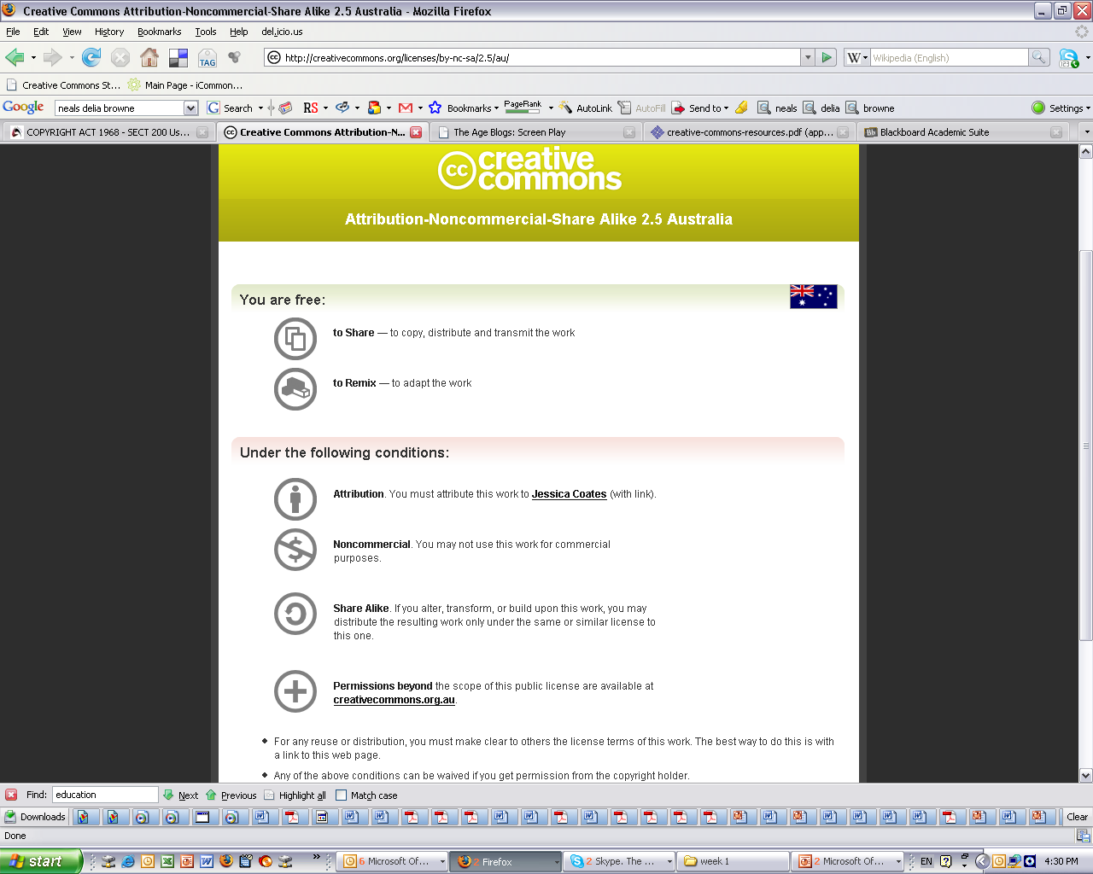
Licences
AUSTRALIA
part of the Creative Commons international initiative
Notes:
. . .to the licence deed, which sets out the licence in plain english terms
You can see the licence element symbols here
By clicking on this link here, you can access . . .

Slide 9
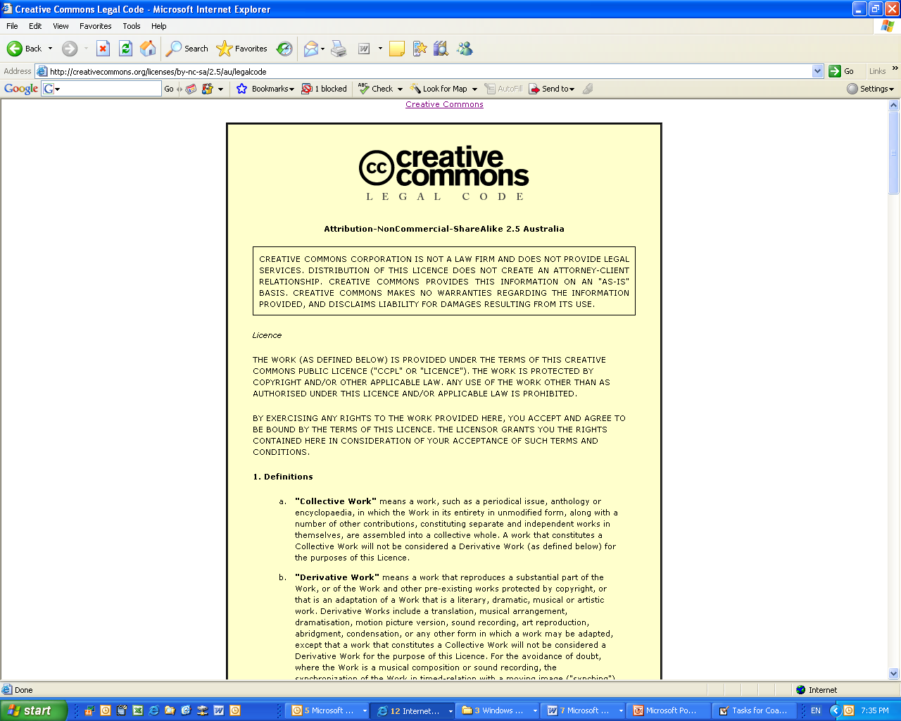
Licences
AUSTRALIA
part of the Creative Commons international initiative
Notes:
The full licence code – which sets out the licence in full legal terms

Slide 10
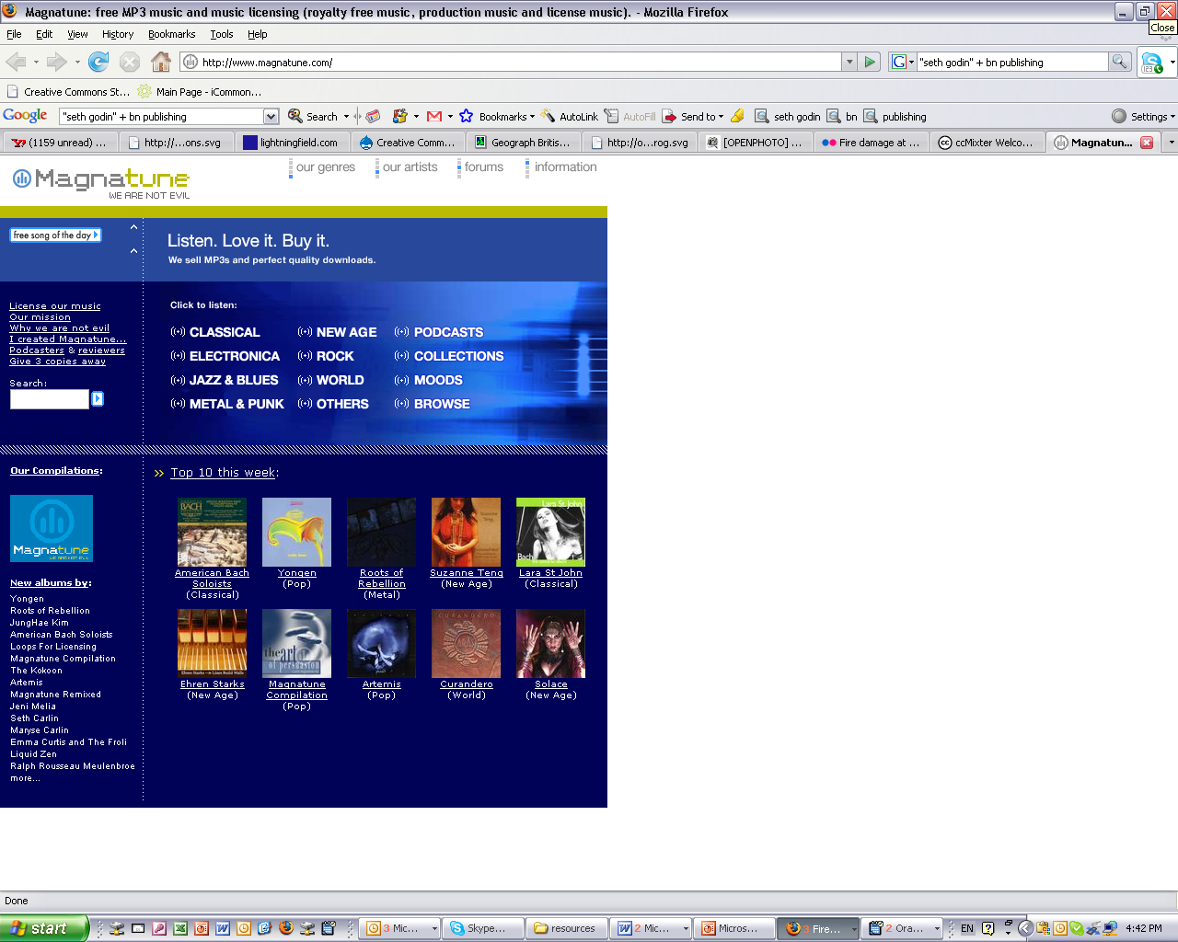


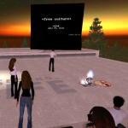


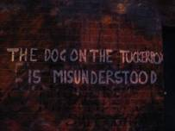


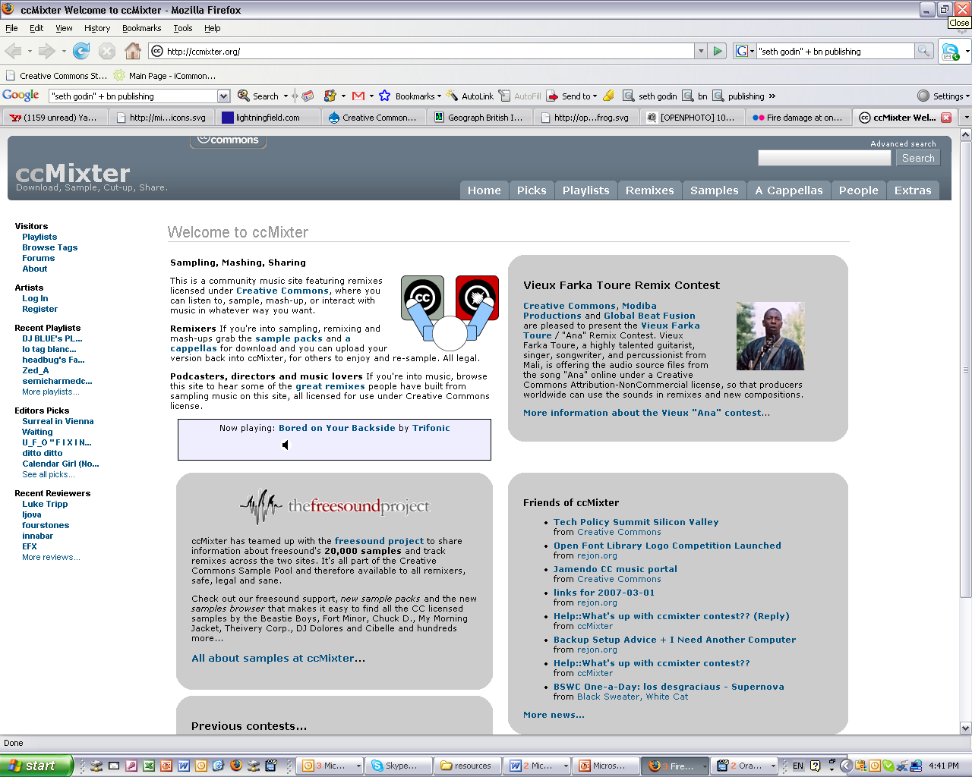
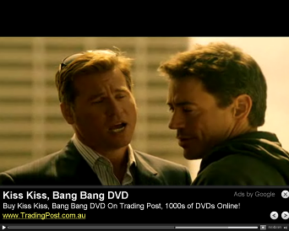



Slide 11
CC as a resource
AUSTRALIA
part of the Creative Commons international initiative
CRICOS No. 00213J

Slide 12
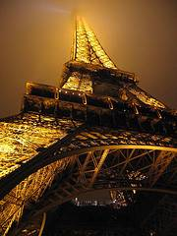
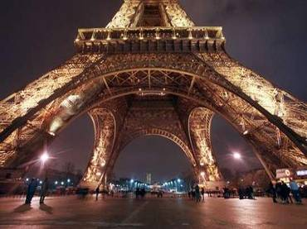
Using CC material
www.smh.com.au
Eiffel Tower at night by rednuht,
http://www.flickr.com/photos/rednuht/275062341/,
Creative Commons Attribution 2.0
http://creativecommons.org/licenses/by/2.0/deed.en
AUSTRALIA
part of the Creative Commons international initiative
CRICOS No. 00213J

Slide 13
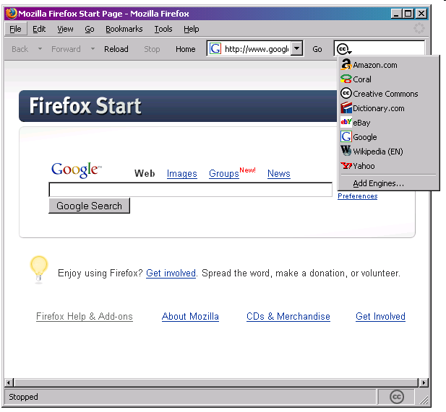
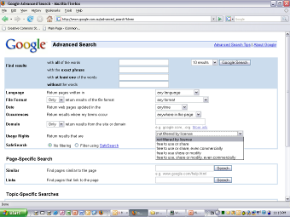
Finding CC material
Built in metadata makes CC materials easy to find.
Search engines with dedicated CC functions include Google, Yahoo, Flickr and Firefox (Linux web browser).
Creative Commons homepage lets you search by type of material.
AUSTRALIA
part of the Creative Commons international initiative
CRICOS No. 00213J
Notes:
But how do you find all of this material?
One of the most important innovations of the CC licensing model was to make the licences machine readable.
This means that, if the XHTML text is correctly embedded in the work, the work can be searched for through a series of specific CC search engines
this is probably one of the biggest benefits of using CC licensing – it makes it easy for those looking for material they can use to find your material, and gives you direct access to the open source and re-mix communities
Google, Yahoo, flickr and blip.tv all provide specific CC search tools, as does the firefox web browser

Slide 14











Finding CC material
AUSTRALIA
part of the Creative Commons international initiative
CRICOS No. 00213J

Slide 15
Before using CC material
Check that you’re following the licence (ask for extra permission if you need it)
Make sure your use isn’t ‘derogatory’
Are there any other rights you need?
Don’t forget to attribute
Use common sense
AUSTRALIA
part of the Creative Commons international initiative
CRICOS No. 00213J

Slide 16
CC as a tool
AUSTRALIA
part of the Creative Commons international initiative
CRICOS No. 00213J

Slide 17
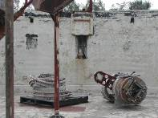
Why open license?
Increases reach and reputation
Facilitates collaboration
Gives new value to stagnant material
Community engagement
Reduced admin
Legal clarity
Increases sum of human knowledge, encourages innovation
AUSTRALIA
part of the Creative Commons international initiative
CRICOS No. 00213J

Slide 18
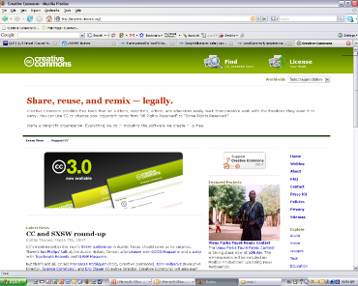
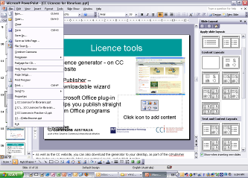
Choosing a licence
Licence generator – on CC website – uses simple questions to determine appropriate licence
Also available:
  ccPublisher – downloadable desktop wizard
  Microsoft plug-in –allows you to CC license straight from Office programs
  Individual site generators eg Flickr
AUSTRALIA
part of the Creative Commons international initiative
CRICOS No. 00213J
Notes:
As well as the CC website, you can also download the generator to your desktop, as part of the ccPublisher
This helps you automatically label your material as CC, and publish it online
In an interesting development, Microsoft has also recently released an plugin that allows you to label any work created in an Office as CC.
A number of sites also let you licence your material as cc – including flickr, and blip.tv

Slide 19
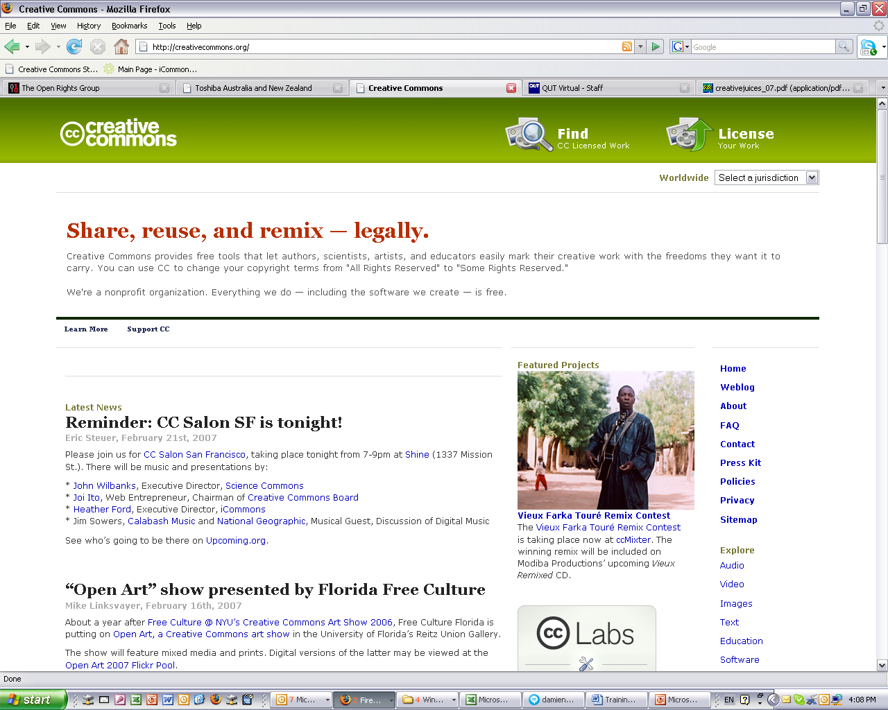
Licences
AUSTRALIA
part of the Creative Commons international initiative
Notes:
To help choose the most appropriate licence, the CC website provides a “licence generator”, which asks simple questions to determine what people are happy to use

Slide 20
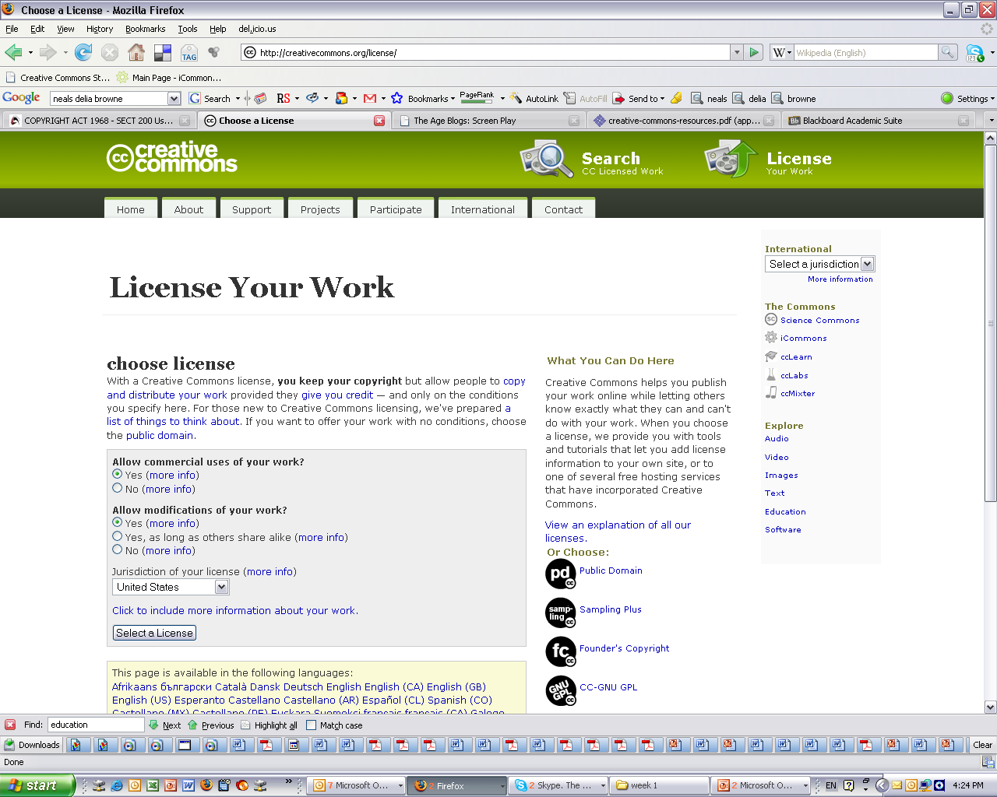
Licences
AUSTRALIA
part of the Creative Commons international initiative

Slide 21
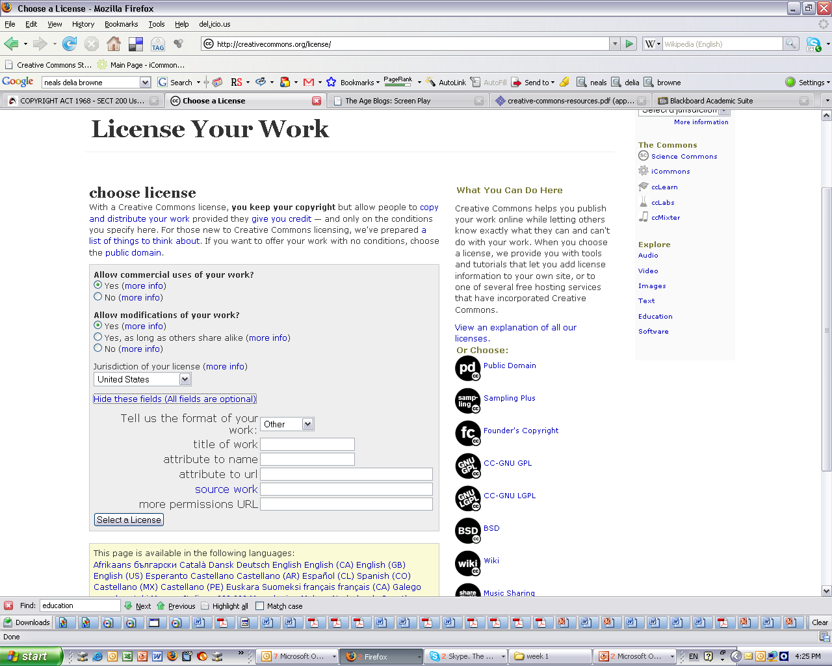
Licences
AUSTRALIA
part of the Creative Commons international initiative

Slide 22
Licences
AUSTRALIA
part of the Creative Commons international initiative
Notes:
. . .to the licence deed, which sets out the licence in plain english terms
You can see the licence element symbols here
By clicking on this link here, you can access . . .

Slide 23
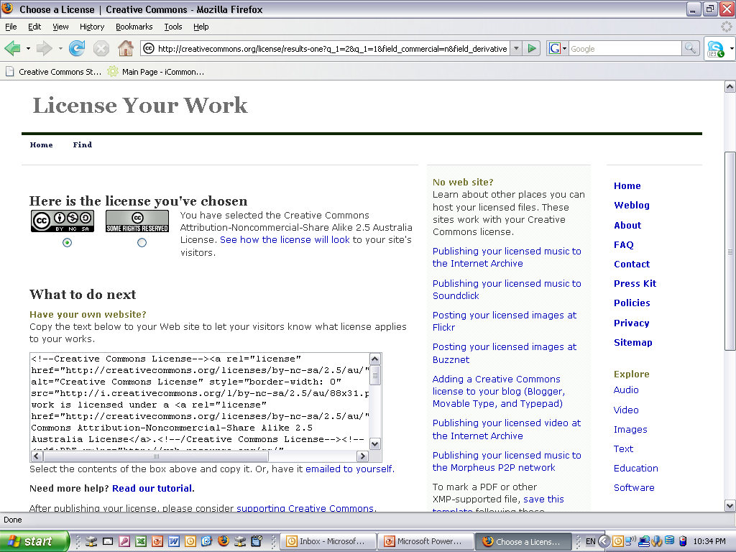
Licences
AUSTRALIA
part of the Creative Commons international initiative
Notes:
Selecting a licence takes you through to a page that provides you with some XHTML text that you can copy onto you website
This basically ‘embeds’ the cc licence into your work, and displays the ‘licence button’ on your site
By clicking on the button, you’re taken through. . .

Slide 24
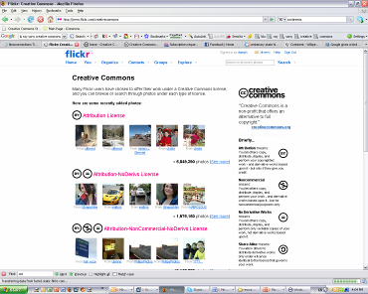
Licence tools
ccPublisher – downloadable desktop wizard
Microsoft plug-in –allows you to CC license straight from Office programs
Individual site generators eg Flickr
Plug-ins / wizards for other programs, formats etc
AUSTRALIA
part of the Creative Commons international initiative
CRICOS No. 00213J
Notes:
As well as the CC website, you can also download the generator to your desktop, as part of the ccPublisher
This helps you automatically label your material as CC, and publish it online
In an interesting development, Microsoft has also recently released an plugin that allows you to label any work created in an Office as CC.
A number of sites also let you licence your material as cc – including flickr, and blip.tv

Slide 25
What to CC license?
You can publish/archive:
short works
long works
previews/excerpts
samples
‘drafts’
material that would not otherwise be published – eg source material, back catalogue, ‘junk’
AUSTRALIA
part of the Creative Commons international initiative
CRICOS No. 00213J

Slide 26
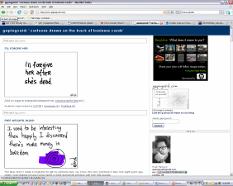
Where to share material
Own website
Popular sites – eg Flickr, Garageband.com Myspace
Remix communities – eg ccMixter, Opsound
CC businesses – eg Revver, Magnatune
Own website
Peer-to-peer, bit torrent
AUSTRALIA
part of the Creative Commons international initiative
CRICOS No. 00213J

Slide 27
Before using CC licences
Things to think about:
Who do you want to use the material, and when? eg global, perpetual
Are you choosing the right licence? eg do you want them to be able to change your material?
Do you have the rights to license the material? are you using anyone else’s material?
AUSTRALIA
part of the Creative Commons international initiative
CRICOS No. 00213J

Slide 28

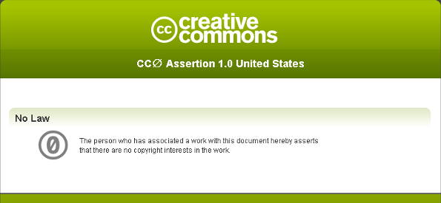
CC Zero
AUSTRALIA
part of the Creative Commons international initiative
CRICOS No. 00213J
Notes:
Another interesting “second generation” CC user is Revver
Revver is a free video sharing site, similar to Youtube
But, unlike Youtube, Revver aims to take advantage of the popularity of sharing videos online to provide a revenue-raising model for video makers
And as part of this business model, it requires that all people upload their material under a CC BY-MC-ND licence
Revver’s still in its early days, but it does already have a success story in the “extreme diet coke and mentos experiment” video
hopefully at least some of you have already seen this online
But just in case you haven’t here it is
By June this year this video has been downloaded more than 6 million times, and earned its makers over US$30,000 in revenue
It’s hosted a number of ads - first for the movie “Kiss Kiss Bang Bang” – and then for mentos.
Strangely, coke wasn’t interested
This has encouraged other popular online videos, such as “ask a ninja”, to put themselves on Revver

Slide 29
Thanks
http://www.creativecommons.org
http://www.creativecommons.org.au
info@creativecommons.org.au
This slide show is licensed under a Creative Commons Australia Attribution licence. For more information see http://creativecommons.org/licenses/by/2.5/au/.
AUSTRALIA
part of the Creative Commons international initiative
CRICOS No. 00213J

